Slide 1
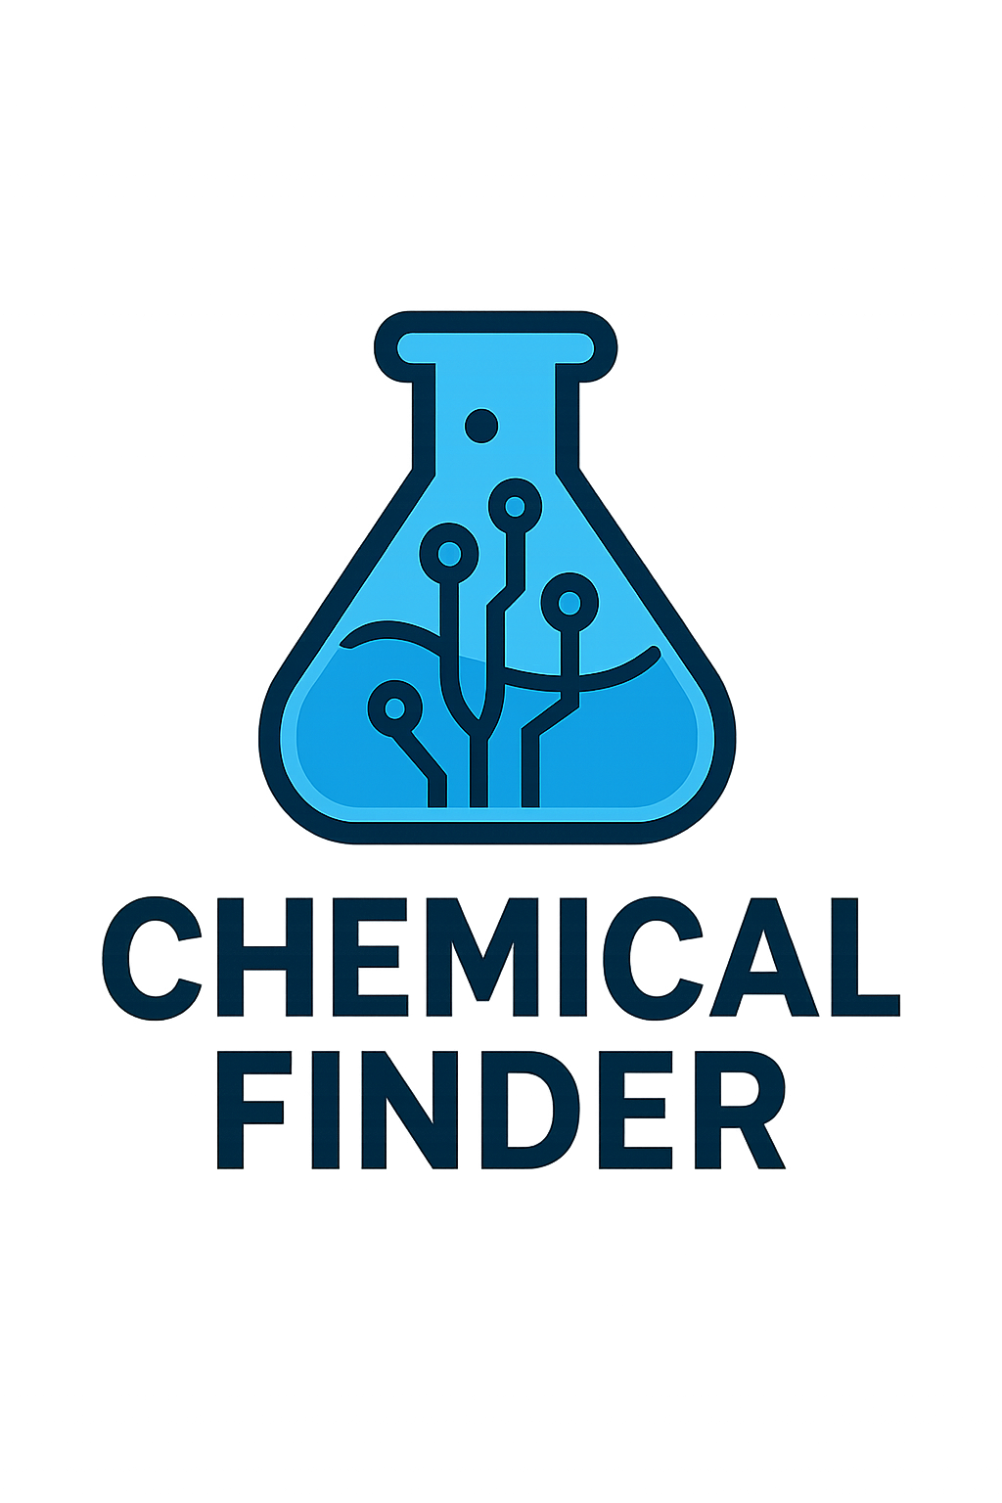

Slide 2
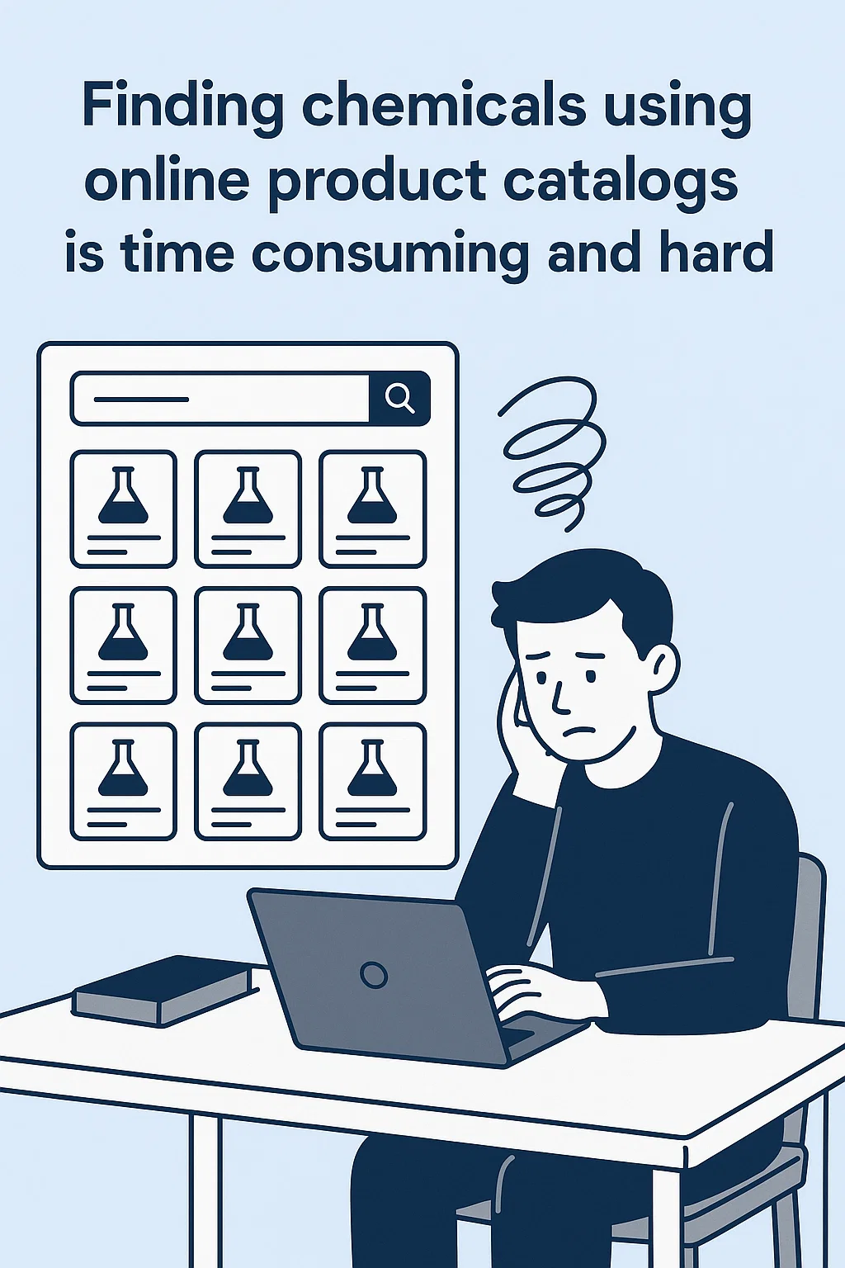
The Problem We’re Solving
Stepan’s product catalog is massive and complex, with hundreds of specialty chemicals and formulations.
Customers, sales teams, and formulators struggle to quickly find the right product that meets technical, regulatory, or performance needs.
Current search tools only work if you already know the exact name or technical keyword — leaving people frustrated and wasting time.

Slide 3
Who Needs This
Primary users: Formulators, sales teams, and customers across cleaning, personal care, agriculture, food, and industrial markets.
Key traits: Need quick answers, not deep chemical expertise; often unfamiliar with Stepan’s naming conventions.
Why this group matters: Global, multi-billion-dollar markets; high demand for faster product discovery and regulatory compliance.

Slide 4
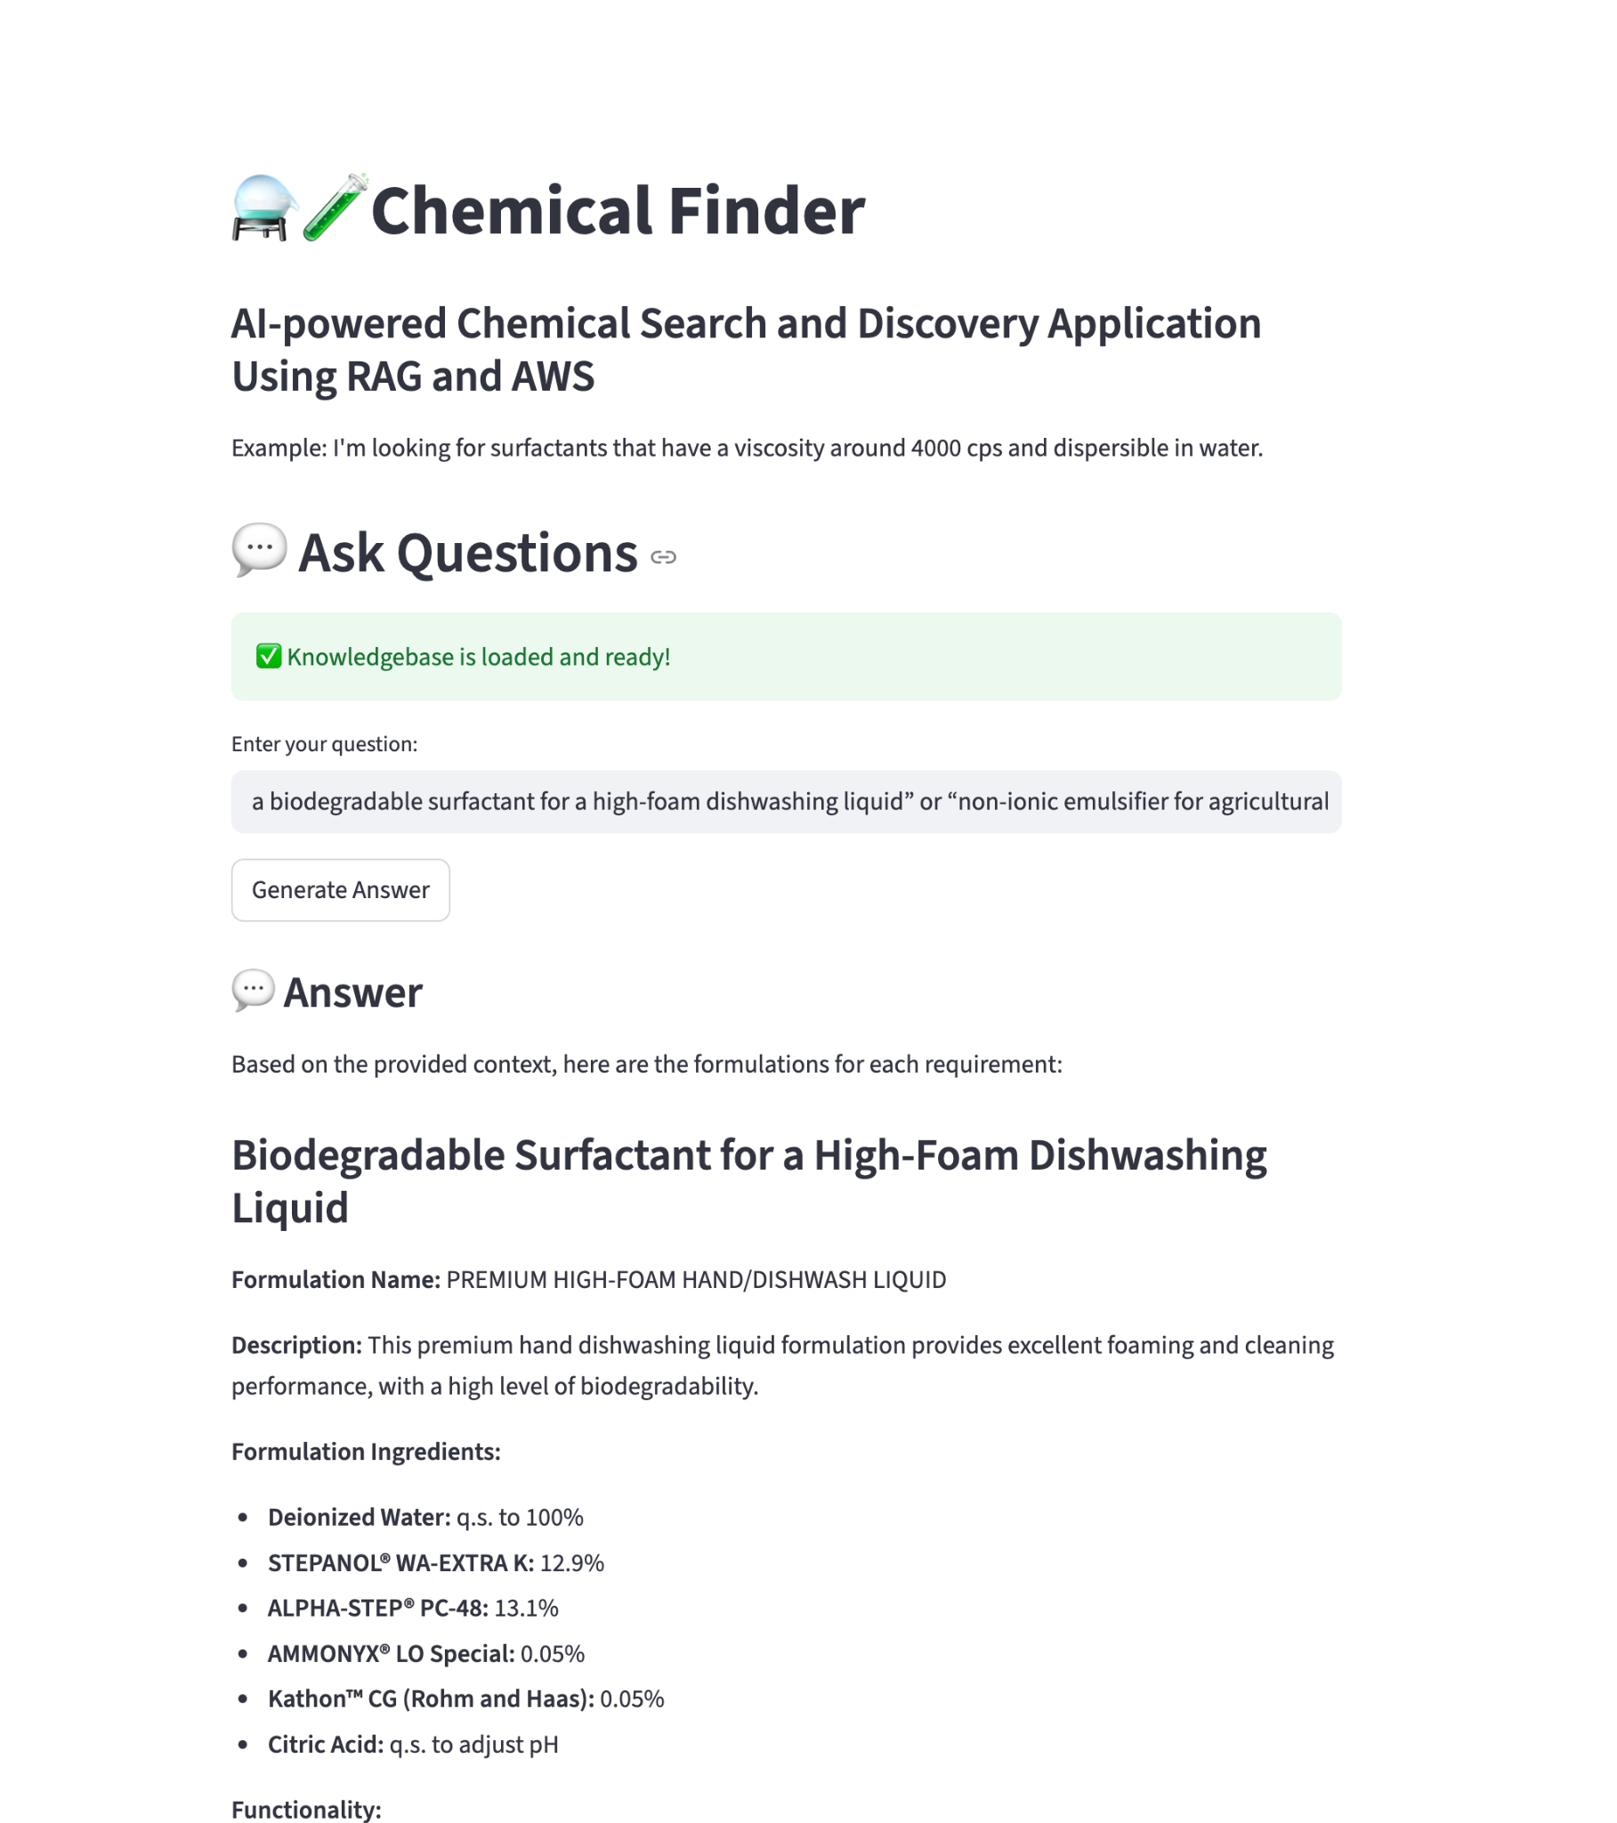
Our AI-Powered Solution
RAG will sort through Stepan’s catalogue of chemicals and find relevant chemicals/products according to your search query
Users can simply type natural language queries like “biodegradable surfactant for high-foam dishwashing liquid.”
With this tool, users can now find the right product in minutes instead of hours — improving discovery, reducing support requests, and speeding up decisions.

Slide 5
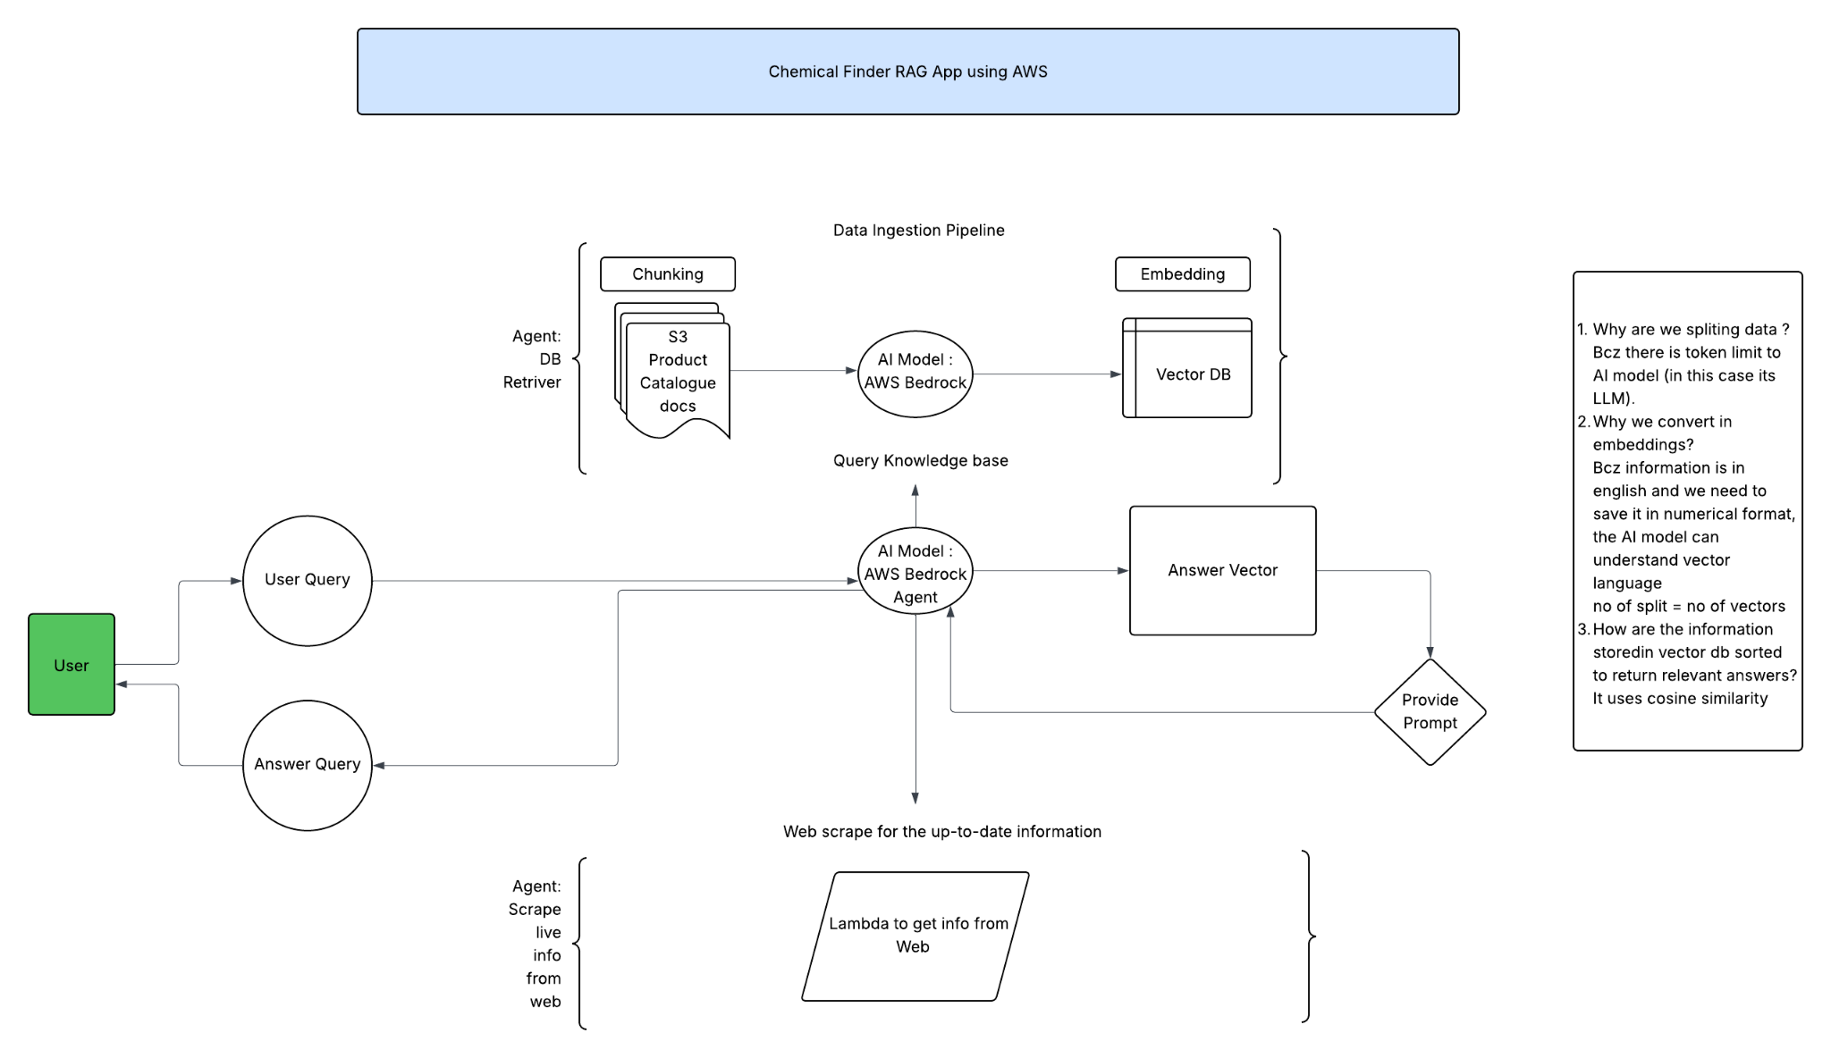
Current Technical Status of Product
Project is currently in Beta, Expecting to launch at end of 2025
Prototype is able to provide detailed responses
Working on improving quality of responses in terms of matching chemical details more precisely and return a broader selection of relevant chemicals

